Slide 1
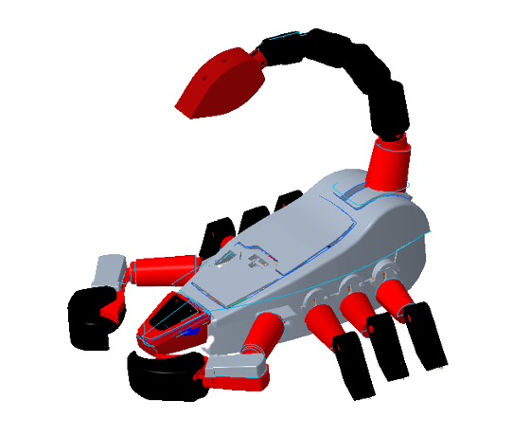
Scorpion Robot Assembly
Matteo Cappellini
Manuel Delucchi
Jack McKenna
Notes:
Hello we are group4 etc

Slide 2
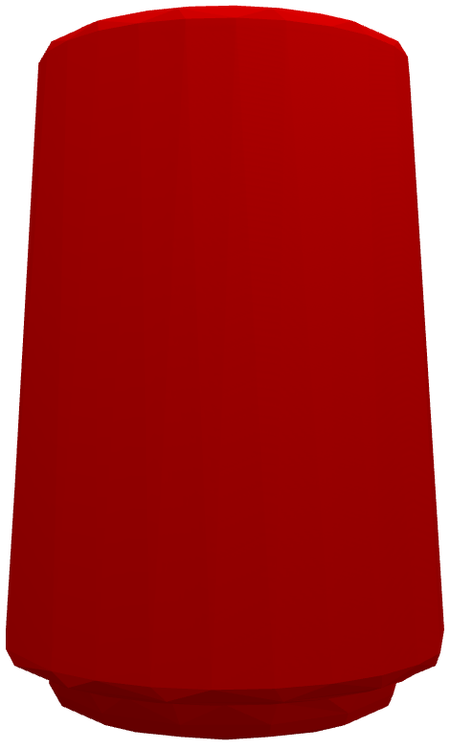
Part 26
Shell
Used the Shell feature, to empty the desired face of the object
Swept blend
Started by drawing the median line
Defined shape of the base
Created the swept blend feature
Extrude
The extrude feature was used for internal cylinders, walls and openings
Notes:
C
To design the part26 we first used the swept blend feature to design the general shape of the object and shell to empty the bottom face of the piece that was then completed by modelling all the needed extrusions

Slide 3
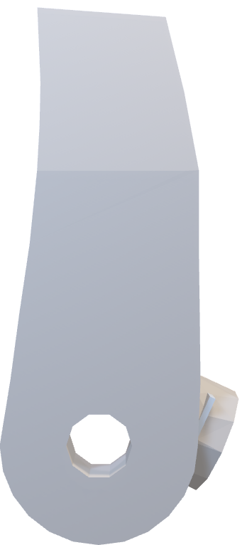
Part 27
Split Body
Shell
The body was split to be able to use the draft feature on a specific section
Used the Shell feature, to empty the desired face of the object
Draft
Curved the bottom body at an angle of 7°
Extrude
Used to create all the features, such as cylinders, walls and openings
Merge
Merge the two bodies back together after the needed changes
Notes:
C
The design of part 27 was instead a little trickier, in fact we had to (do?) a lot of sketches to represent this piece’s curvature at the best of our capacity (check grammar), than we divided it in two parts via a plane just so that we could split the two body, get the correct rounding via the draft feature and then put the two bodies back together. Than we completed this part by following the same steps seen for part26

Slide 4
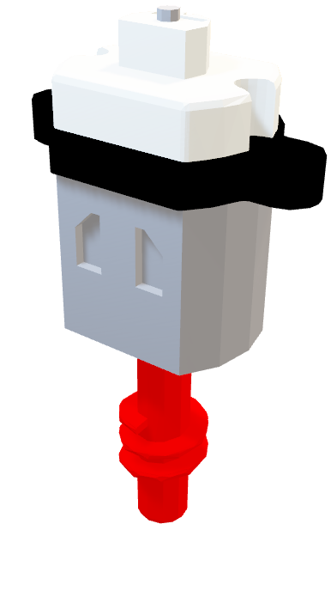
Motor
Mirror
Simplify the modelling
Helical Sweep
Worm Shaft
Used the cylinder axis as reference
Created the helix profile
Defined an axis of revolution
Formed the helix shape
Round
Most edges were rounded
The model becomes more presentable
Notes:
D
Here is the motor part. We started by using the extrude feature to create the structure, following the same approach as previous models. To simplify the modeling process, we used the mirror feature. Once the basic structure was in place, we proceeded to round the edges slightly to match the curved design of the actual model.
Additionally, there is another component to consider: the worm shaft. To construct this part, we relied on the cylindrical axis as a reference point. Firstly, we created a line to serve as the helix profile, defining its axis of revolution. Finally, we formed the shape of the helix by creating another sketch.

Slide 5
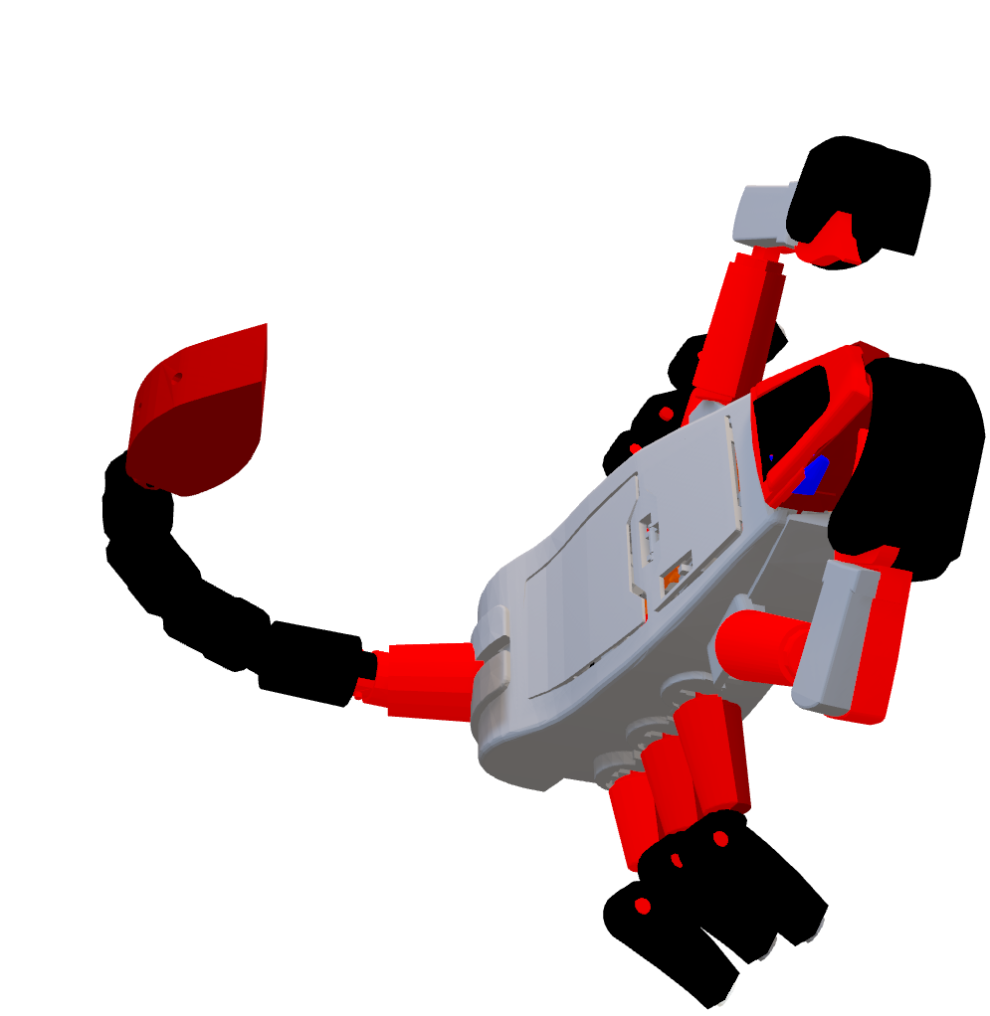
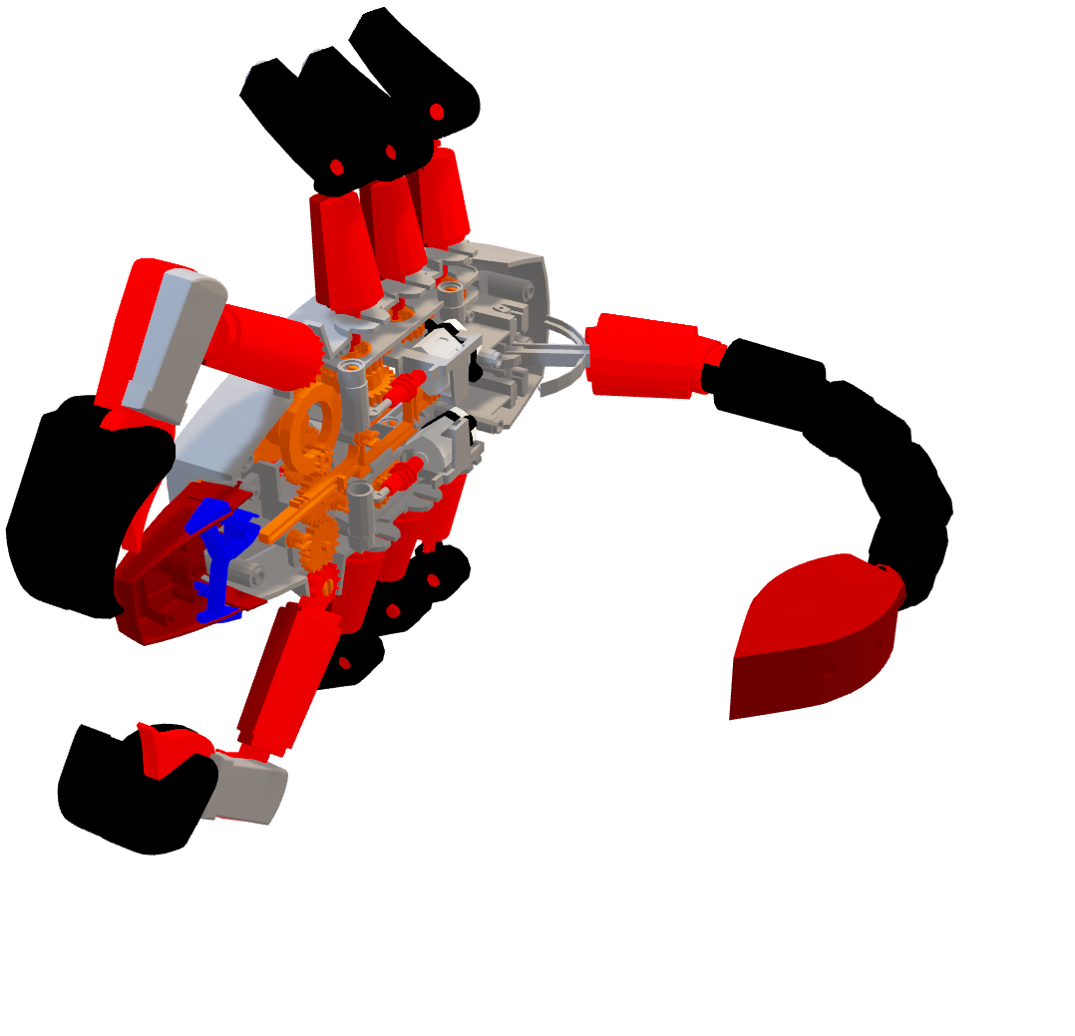

Full Assembly
Part 26
We followed the manual step-by-step
Starting with the bottom frame and the internal mechanisms
Then Legs, Claws and Tail
Motor
Part 27
Notes:
D
Here we have the full assembly of our scorpion robot. You can see part26, … In order to assemble the robot we followed the manual step-by-step starting with the bottom frame, the internal mechanisms and then the legs, claws and the tail. It’s worth mentioning that we utilized subassemblies in order to make the assembly process more efficient.

Slide 6
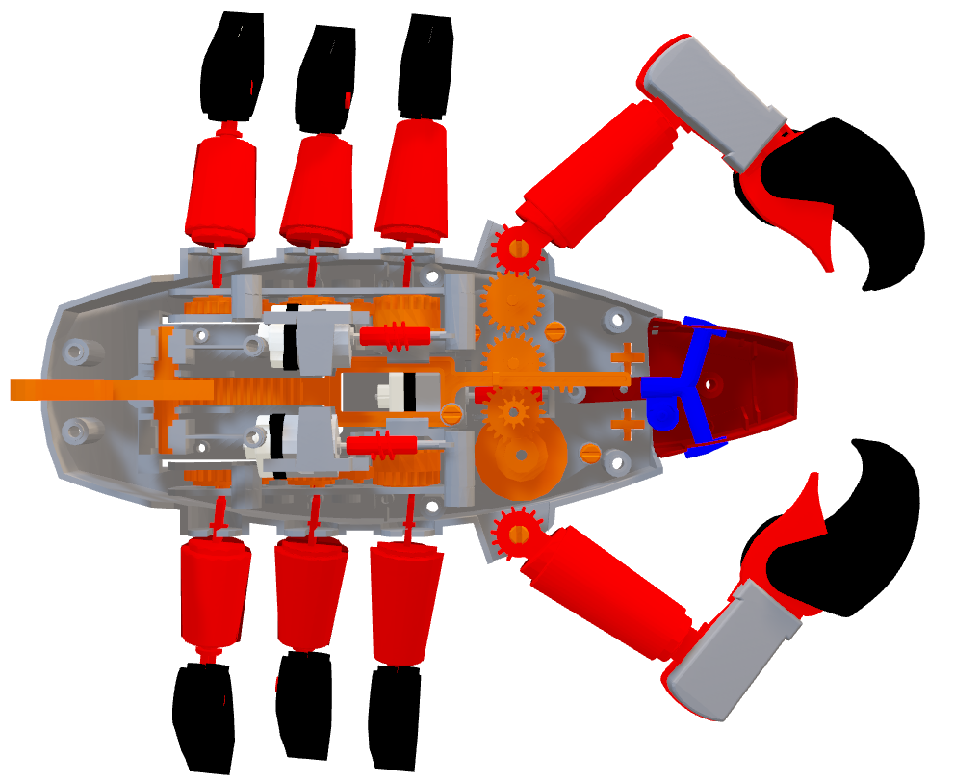
Connections
Rigid connections for static parts
Pin for each gear and the claws
A slider to control the tail
6 bearing-cylinder joints to make the legs move
Notes:
C
In order to simulate the mechanic of this robot we used 5 different types of connections:
Rigid: to connect the parts that are static and fixed to each other
Pin: for the spinning parts, such as the gears
Slider: to move the piece that controls the tail
Bearing-cylinder: to simulate the joint motions of each leg in the best possible way

Slide 7
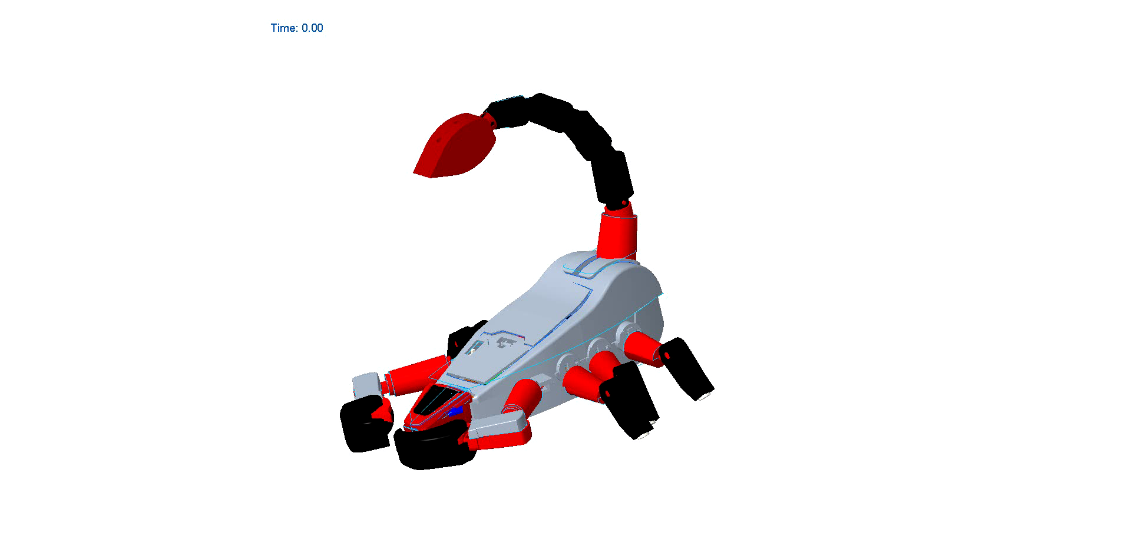
Simulation
Notes:
C
And here we can see the simulation of the robot showcasing how these joints work when motorized by three different servo motors, that simulate the behaviour of the real ones: one for each set of legs and one for the claws-tail mechanism

Slide 8
Challenges
What we learned
Cooperation and communication with other groups
Managing work and make it easier by using
Colours
Codenames
Subassemblies
Mistakenly set one of our parts to inches
Some parts were not properly matching
Notes:
D
Finally, we had to face some challenges: we mistakenly set one of our parts to inches instead of mm but we managed to solve this problem real quick by consulting the Creo online documentation. Then, some of our parts with other teams parts were not properly matching so we had to learn how to cooperate and communicate with them. We also learned hoe to properly manage how work and make it easier by colouring for each of our parts, giving names to the features of our parts and making different subassemblies in order to overcome later problems.

Slide 9
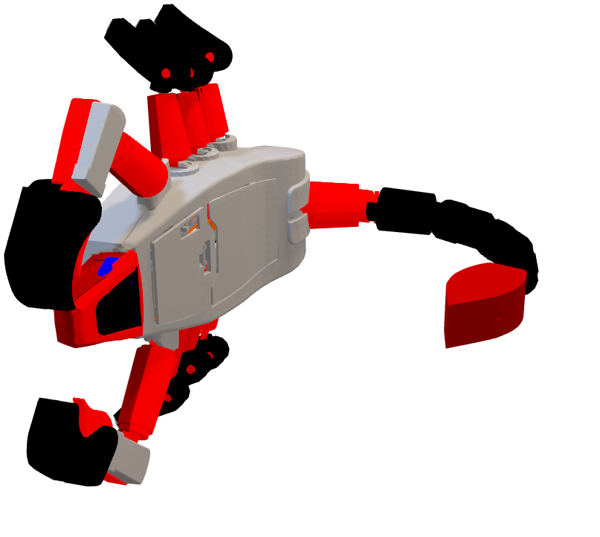
Thank you!
Notes:
D
Thank you for your attention!

